Slide 1

Building a True Random Number Generator (TRNG) Final presentation and demo
Arun Alex
Mohammed fatah
Vamshi Vavilla
Simon Solis
November 25, 2025
CSE 4392: SPECIAL TOPICS

Slide 2
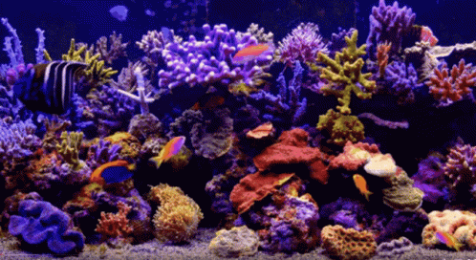
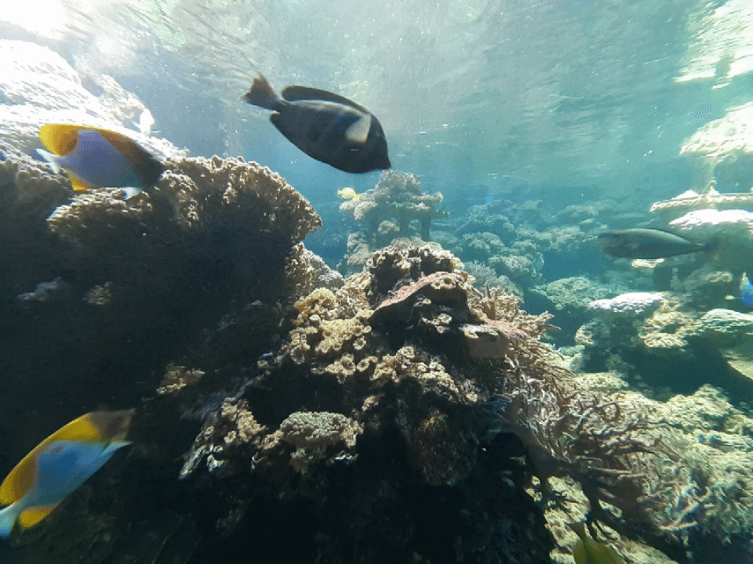
What the Project is About (Recap)
Designing a True Random Number Generator that extracts randomness from fish movements in an aquarium captured via a camera.

Slide 3
What is a True Random Number Generator?
Definition: A True Random Number Generator (TRNG) derives randomness from physical, unpredictable phenomena in the real world rather than from mathematical algorithms.
Key Characteristics:
Entropy Source is Physical, not computed (e.g., noise, motion, timing jitter, natural systems).
Non-Deterministic — output cannot be reproduced, even if initial state is known.
Unaffected by Seed Predictability — unlike PRNGs (which produce repeatable sequences).
Used in Security-Critical Systems such as encryption, authentication, and key generation.

Slide 4
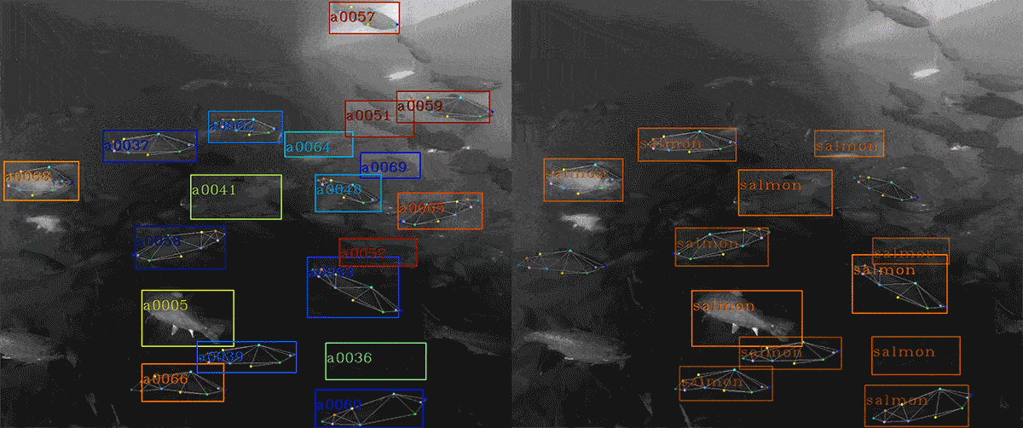
What the Project is About
Entropy Source: Unpredictable paths, speeds, and interactions of fish in water create chaotic patterns (combining biological behavior with fluid dynamics).
Process: Software streams the live YouTube video feed; image processing tracks the locations of a few fish (e.g., their x-y coordinates in the frame) and compares their relative positions (e.g., distances or angles between them) alongside analyzing pixel changes from their movements to generate random bits.
Notes:
Fish movements—random paths, speeds, and interactions—create chaotic patterns. We track fish positions and pixel changes in video frames to extract entropy and generate random bits.

Slide 5
TRNG vs PRNG (Pseudorandom number generator)
Aspect | TRNG (True) | PRNG (Pseudo)
Source | Physical world (nature/hardware) | Algorithm + initial seed
Predictability | Unpredictable | Predictable if seed is known
Reproducibility | Not repeatable | Repeatable sequence
Security Use | High-security cryptographic systems | Simulation, games, non-secure RNG

Slide 6
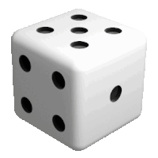
Problem Overview / Motivation Why randomness matters in cryptography/security
Cryptographic systems rely on randomness to generate secure keys, nonces, session tokens, and authentication challenges.
If the randomness used is predictable, the entire security system collapses, regardless of the encryption algorithm strength.
Entropy directly determines key strength. A 256-bit AES key with only 40 bits of true entropy is effectively a 40-bit key, regardless of algorithm strength.
Attackers do not break encryption first — they break randomness.
Notes:
Cryptographic systems depend on strong randomness for secure keys and tokens. Weak entropy undermines even the strongest encryption. Attackers often target poor randomness, not the algorithm itself

Slide 7
Weakness of PRNGs (Pseudo-Random Number Generators) in secure systems
PRNGs use deterministic algorithms initialized with a seed.
If the seed is guessed, leaked, or low-entropy, an attacker can reconstruct all past and future outputs.
Many systems unintentionally reuse or weakly derive seeds, leading to catastrophic key reuse.
Notes:
PRNGs are deterministic. If the seed is weak or leaked, attackers can predict all outputs. Many real-world systems have failed due to poor seed management

Slide 8
Real-world attacks exploiting weak random sources
Incident | Failure Mode | Impact
Debian OpenSSL Bug (2008) | Removed entropy-gathering code → RNG had only 15 bits of entropy | Millions of SSH keys globally were cloneable
Sony PlayStation 3 ECDSA Hack | RNG reused the same k value in signatures | Private key for Sony firmware signing was exposed
Android Bitcoin Wallet Hacks (2013) | Java SecureRandom failed on early Android → repeated nonce reuse | Attackers recovered private blockchain keys and stole BTC
Netscape SSL (1996) | RNG seeded with time + PID only | SSL sessions decryptable by attackers

Slide 9
High-Level Objective of the Project
Develop a True Random Number Generator (TRNG) using fish movements in a live aquarium feed as the entropy source.
Capture and process live video frames to extract unpredictable patterns from fish behavior (speed, direction, collisions, ripples).
Convert raw entropy into usable randomness through statistical conditioning (e.g., hashing, whitening).
Validate output randomness using NIST SP 800-22 tests, focusing on uniformity, independence, and unpredictability.
Goal: Provide a proof-of-concept TRNG that demonstrates how natural, biological systems can enhance cryptographic security.
Notes:
“The core objective of our project is to design a True Random Number Generator that uses fish behavior as its entropy source. Unlike software-based PRNGs, which can be reverse engineered, this approach captures natural chaos that cannot be predicted.”
“We use a live aquarium video feed and track the unpredictable movements of fish — their speed, direction changes, and interactions. These movements are influenced by biological behavior and water dynamics, making them highly chaotic.”
“The raw data isn’t perfect randomness. So, we apply conditioning techniques like hashing or whitening to remove any patterns or bias. This step converts raw entropy into cryptographically usable randomness.”
“To confirm quality, we run the NIST SP 800-22 randomness test suite, which checks things like uniformity, independence, and unpredictability.”
“The final deliverable is a working prototype — a complete pipeline from live video input to validated random numbers that could be used in cryptography.”

Slide 10
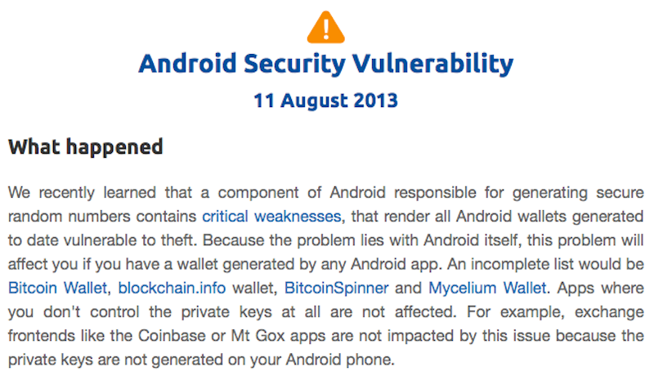

Why This Project is Important
History shows failures: weak RNGs broke SSL/TLS and Bitcoin wallets.
(e.g., Android Bitcoin Wallet RNG bug, 2013).
Conventional TRNGs are costly and not always accessible.
Fish motion provides a natural, continuous, and chaotic entropy stream.
Strong randomness safeguards keys, tokens, and encrypted sessions.
Weak randomness risks prediction attacks, bypassed protections, and fraud.
Notes:
“This project is important because history shows us that weak randomness has led to serious security failures. For example, the Android Bitcoin Wallet bug in 2013 was caused by poor RNG, and it directly led to stolen funds.”
“Similarly, researchers in 2012 showed that many internet servers had weak keys because of bad randomness in SSL/TLS, which made them vulnerable to attacks.”
“While hardware TRNGs exist, they are expensive and not always built into consumer devices or IoT systems. That’s a real limitation for security at scale.”
“Our approach is different — fish movement provides a natural, continuous, and essentially free source of entropy. It’s a biological process that attackers cannot predict or replicate.”
“If randomness is strong, cryptographic systems remain secure — keys can’t be guessed, tokens can’t be predicted, and sessions remain private. But if randomness is weak, attackers can break encryption, bypass protections like ASLR, and even manipulate blockchain systems.”

Slide 11
How the Project Relates to Security
Cryptography: Random keys, nonces, and salts must be unpredictable; TRNG ensures resistance against brute force and key recovery attacks.
System Protection: Secure tokens and ASLR rely on randomness—TRNG strengthens these mechanisms against exploitation.
Applications:
VPN/TLS/SSH session keys.
Secure authentication tokens.
Fair blockchain lotteries and online games.
National Security & Financial Systems: Prevents fraud, espionage, and manipulation in sensitive domains where weak entropy sources have historically caused vulnerabilities.
Notes:
“Randomness is the hidden backbone of security. Every cryptographic key, nonce, or salt relies on unpredictability.”
“In cryptography, if randomness is strong, encryption is secure. If it’s weak, attackers can reconstruct keys and break the system. Our TRNG ensures strong entropy at the very foundation.”
“On the systems side, randomness is critical for defenses like ASLR, which randomizes memory addresses to block exploits. If randomness is predictable, those defenses fail.”
“Applications like VPNs, TLS/SSH connections, and even blockchain lotteries all rely on secure randomness. Without it, they are vulnerable to replay attacks or manipulation.”
“The bigger picture is that weak randomness isn’t just a technical issue — it has consequences in finance, defense, and even national security. By using a natural entropy source like fish, we make these systems harder to exploit.”

Slide 12
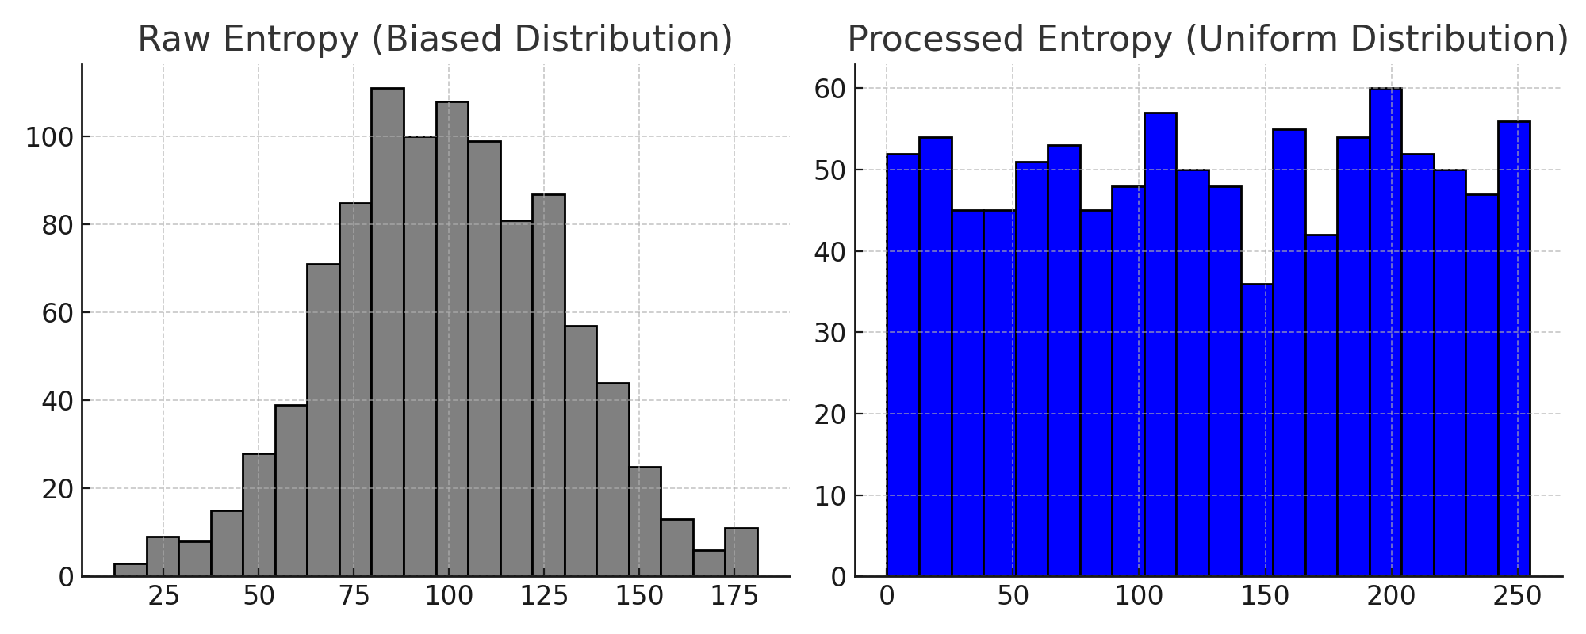
What We Expect to Learn
The Nature of Entropy in Physical Systems
How unpredictable, chaotic events (fish movement, water ripples, lighting fluctuations) generate entropy.
Key insight: randomness is strongest when it’s tied to uncontrollable, natural processes, unlike software PRNGs that can be reverse-engineered.
How Entropy Translates into Random Numbers
Learn the difference between raw entropy (pixel differences, sensor noise) and usable randomness (after hashing/whitening).
Understand why raw data is often biased and needs statistical conditioning.

Slide 13
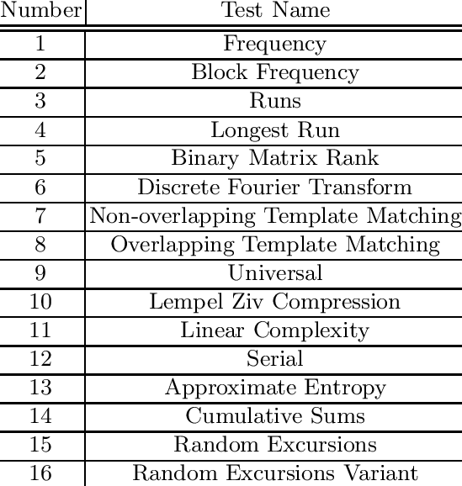
What We Expect to Learn
Security Implications of Weak vs. Strong Randomness
Weak randomness = predictable crypto keys, broken security.
Strong randomness = secure authentication, encryption, and digital trust.
Quality testing: Using NIST randomness tests to measure entropy strength
Security implications: Why weak entropy = broken crypto

Slide 14
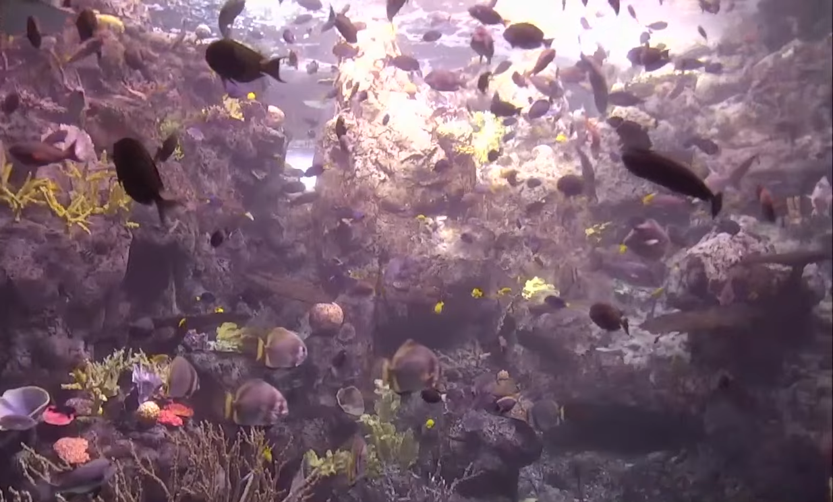
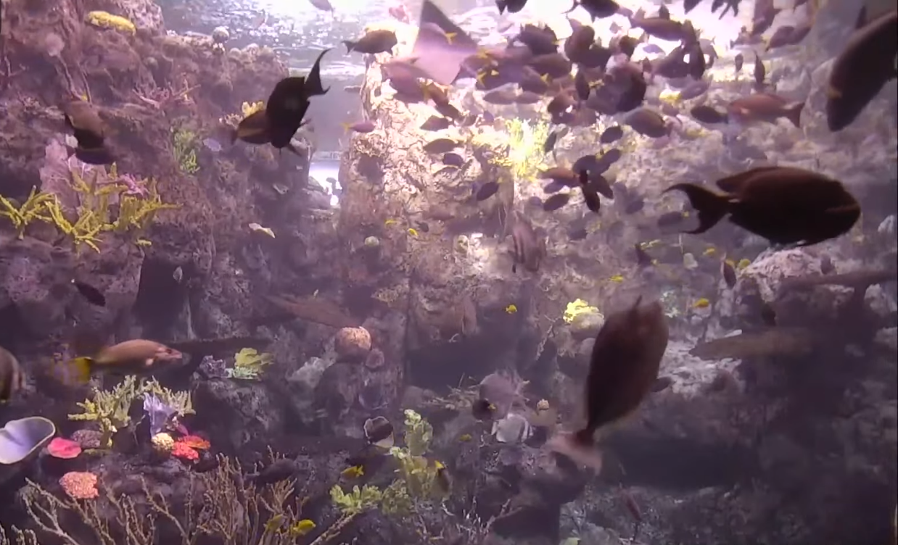

What We Expect to Demonstrate
A Working Entropy Extraction Pipeline
Step 1: Capture aquarium live feed.
Step 2: Extract entropy (frame differences / least significant bits).
Step 3: Condition randomness (hashing/whitening).
Step 4: Output usable random numbers.
Side-by-Side Visual Evidence
Show a snippet of the aquarium feed alongside the generated random numbers.
Demonstrate how natural unpredictability becomes secure cryptographic randomness.

Slide 15
What We Expect to Demonstrate
Entropy Quality Validation
Run basic randomness tests (e.g., NIST SP 800-22).
Demonstrate that output passes key randomness benchmarks (uniformity, lack of correlation, unpredictability).
Security Use Case Simulation
Generate a sample cryptographic key from TRNG output.
Show that the same process with weak PRNG leads to predictable results, while the TRNG output remains secure.

Slide 16
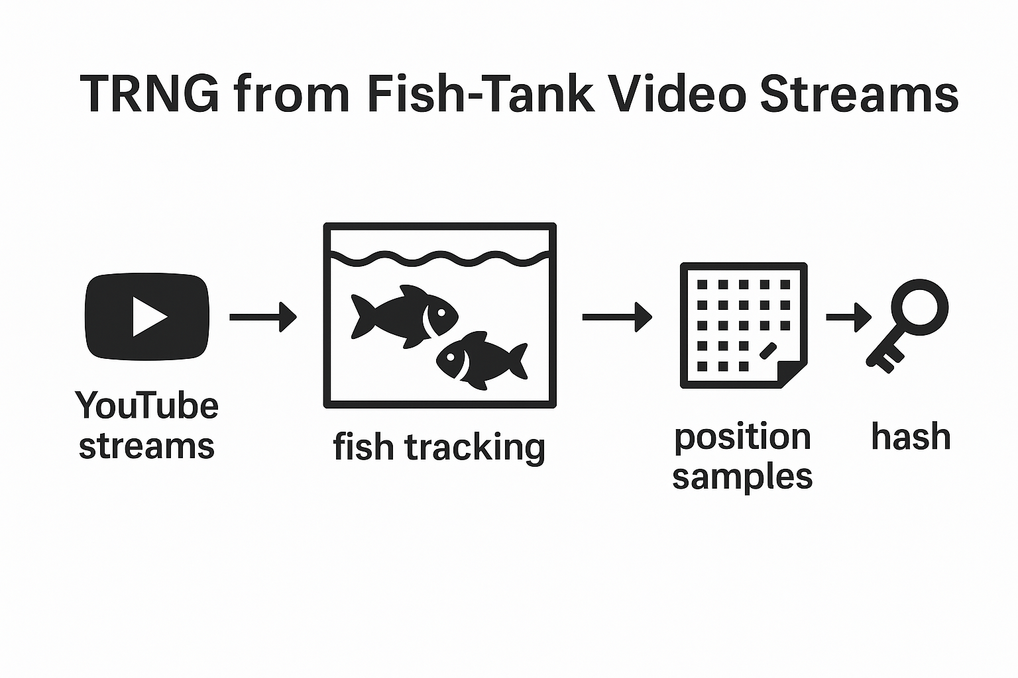
TRNG from Fish-Tank Video Streams
Overall Goal
Extract unpredictable entropy from positions of fish in live YouTube streams and convert it into cryptographic keys.
Input/Output
Input = 2–3 YouTube streams (rotating)
Output: hashed keys (e.g., 256-bit)
Flow of data
Video capture → Fish tracking → Position data → Hash → Key.

Slide 17
Technical Overview
System Pipeline
Fetch frames from 2–3 YouTube streams (rotating).
Preprocess: resize / color convert / stabilize.
Detect fish and compute centroids (x, y).
Select a random subset of fish per sampling epoch.
Quantize/time-stamp values → produce raw bit blocks.
Condition via a cryptographic hash / extractor → produce key material.
Randomness tests (NIST ) and entropy estimation.

Slide 18
Technical Overview
Quantization & Selection
positions → bits
Quantization: map (x,y) pixel coords → fixed integer range (e.g., 0..1023 → 10 bits each).
Concatenation: bits = [timestamp || id || xbits || ybits || area_bits].
Random subset selection: use reservoir sampling or shuffle index each epoch so the set of fish used changes.
Windowing: accumulate N samples per key generation (to reach desired entropy).
Balance between too coarse (loss of entropy) and too fine (overfitting to noise) quantization.

Slide 19
Technical Overview
Hashing & Key Derivation
remove bias & correlations, prevent attacker exploitation.
Use cryptographic hash (SHA-256) to “whiten” concatenated samples.
Options for multiple keys: feed hash output into HKDF to derive multiple keys.
Entropy estimate: Before trusting bits, estimate min-entropy per sample
If entropy is low, increase number of samples per key or use more streams.
Concentrating existing entropy safely.

Slide 20
Technical Overview
Use normalization and dynamic thresholds to reduce environmental bias.
Continuously validate input pipeline integrity against tampering.
Detect anomalies like replayed video or injected synthetic objects.
Log all extraction and processing steps for auditing and traceability.

Slide 21
Technical Overview
Periodically update fish tracking algorithms to improve detection accuracy.
Integrate redundancy by sampling overlapping video segments for higher entropy.
Automate NIST randomness and entropy tests for regular compliance.
Implement real-time alerts when entropy metrics fall below secure thresholds.

Slide 22
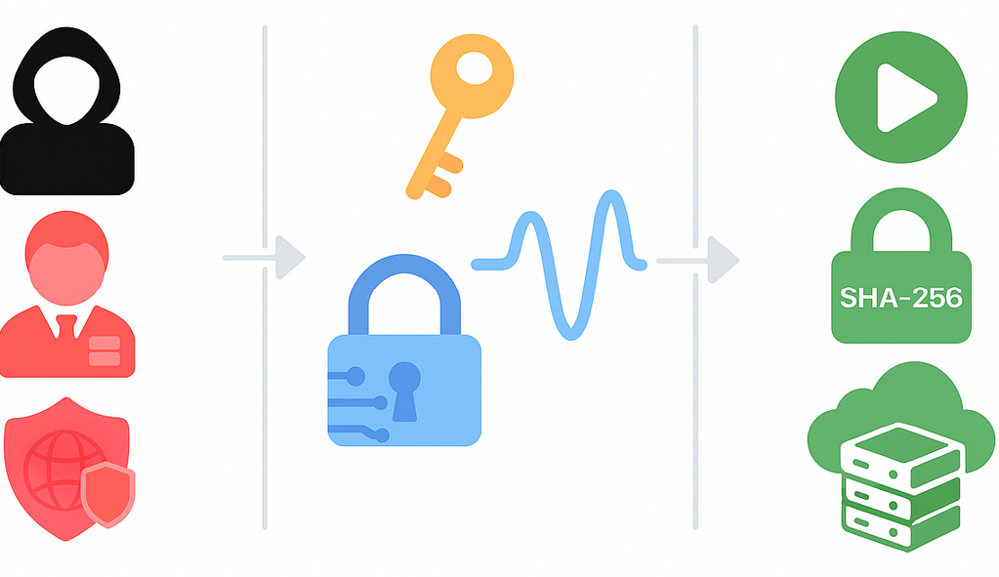
Threat Model Overview
Adversaries
Remote attacker (internet‑based, no physical access).
Insider attacker (access to software pipeline or system logs).
Advanced adversary (state‑level, with resources to manipulate entropy sources).
Assets to Protect
Randomness quality (entropy strength).
Generated cryptographic keys.
Integrity of entropy pipeline (video input → key output).
Assumptions
Public video streams are not under attacker’s direct control.
Cryptographic primitives (SHA‑256, HKDF) are secure.
System environment is not fully compromised.

Slide 23
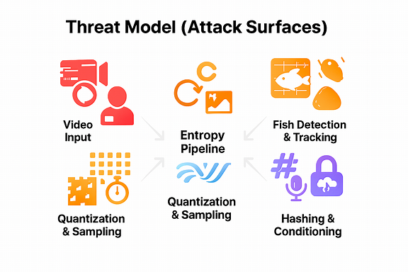
Threat Model: Attack Surfaces
Potential Points of Exploitation:
Video Input
Stream tampering (injected or replayed video).
Frame drops or synchronization attacks.
Fish Detection & Tracking
Adversary introduces artificial patterns (e.g., overlayed graphics, lighting manipulation).
Misclassification of objects as “fish” → biased entropy.
Quantization & Sampling
Predictable mapping if quantization too coarse.
Correlation across frames if sampling rate too high.
Hashing & Conditioning
Weak or omitted conditioning could leak bias.
Side‑channel leakage of pre‑hash values.

Slide 24
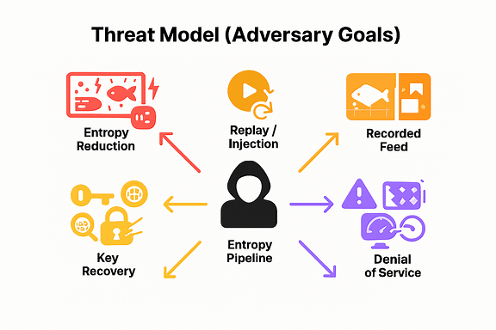
Threat Model: Adversary Goals
What an Attacker Wants
Entropy Reduction
Bias fish movement patterns (e.g., flashing lights, feeding schedules).
Force predictable trajectories → reduce randomness.
Replay / Injection
Replace live feed with pre‑recorded video.
Replay known fish patterns to predict outputs.
Key Recovery
Exploit low‑entropy outputs to brute‑force derived keys.
Correlate multiple outputs to infer internal state.
Denial of Service
Overwhelm system with corrupted frames.
Cause entropy estimator to fail → no keys generated.

Slide 25
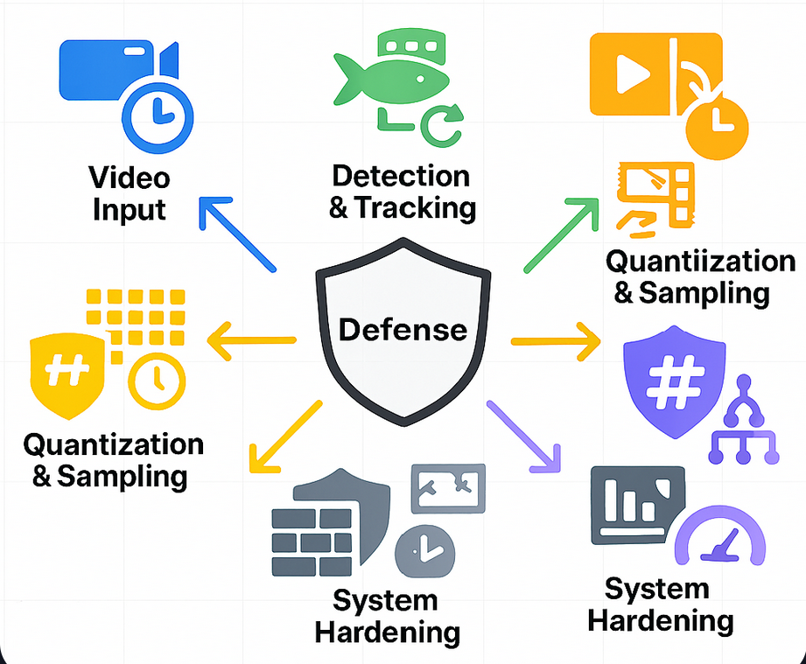
Threat Model: Mitigations & Defenses
How We Defend Against Threats
Video Input
Use multiple independent streams (cross‑entropy).
Timestamp verification to detect replay.
Detection & Tracking
Confidence thresholds: discard low‑certainty detections.
Rotate fish subsets randomly each epoch.
Quantization & Sampling
Fine‑tuned quantization to balance entropy vs. noise.
Randomized sampling intervals to prevent correlation.
Hashing & Conditioning
SHA‑256 whitening removes bias.
HKDF for multiple key derivations.
System Hardening
Drop samples on frame loss or low entropy.
Log metrics for anomaly detection.

Slide 26
Threat Model: Residual Risks & Assumptions
Remaining Risks
If all input streams are compromised, entropy collapses.
Biological systems may have hidden correlations (e.g., schooling behavior).
Extreme adversaries could manipulate aquarium environment.
Assumptions
At least one entropy source remains independent.
Cryptographic primitives remain secure.
System is deployed in a trusted execution environment.

Slide 27
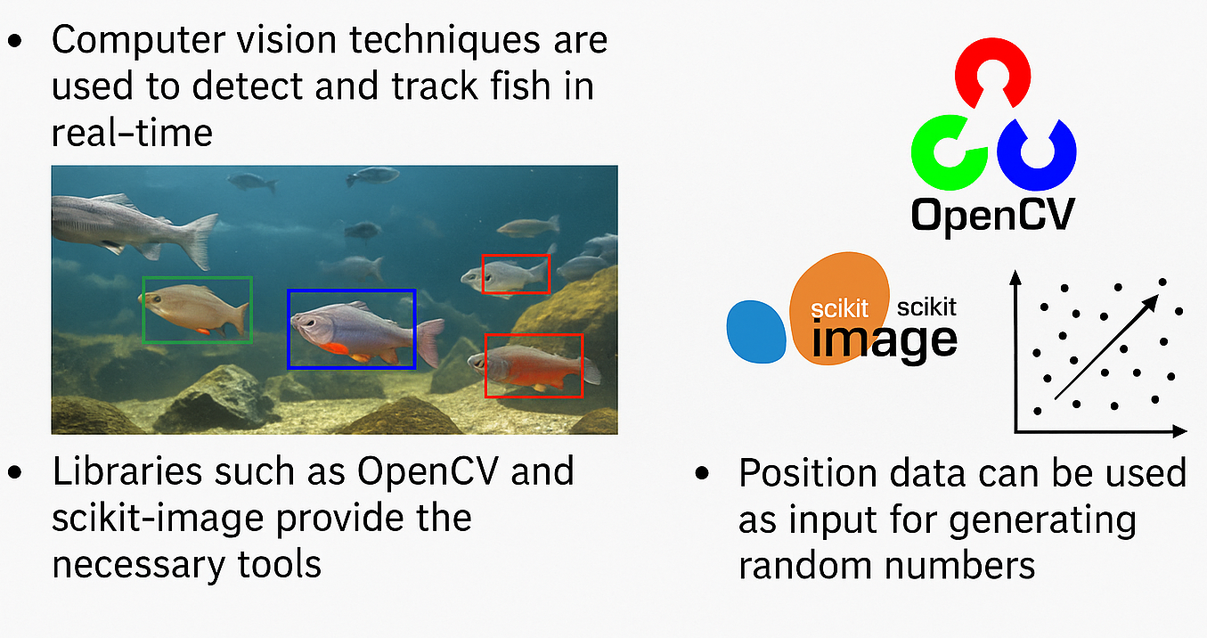
Execution Plan
Video Input & Capture
Libraries: ffmpeg, opencv (cv2), yt-dlp or pytube to obtain stream URLs.
Use cv2.VideoCapture(stream_url) or ffmpeg subprocess to read frames.
Target FPS: 5–30 fps (tradeoff: more samples vs correlated frames).
Sync across streams: use UTC timestamps / monotonic clock.
Video Input & Capture
Deep learning object detector (YOLOv8 / MobileNet SSD) trained for fish (higher accuracy).
Tracking: SORT or DeepSORT to maintain IDs across frames.
Tracking output: for each fish → (id, timestamp, x, y, area, speed_vector).

Slide 28
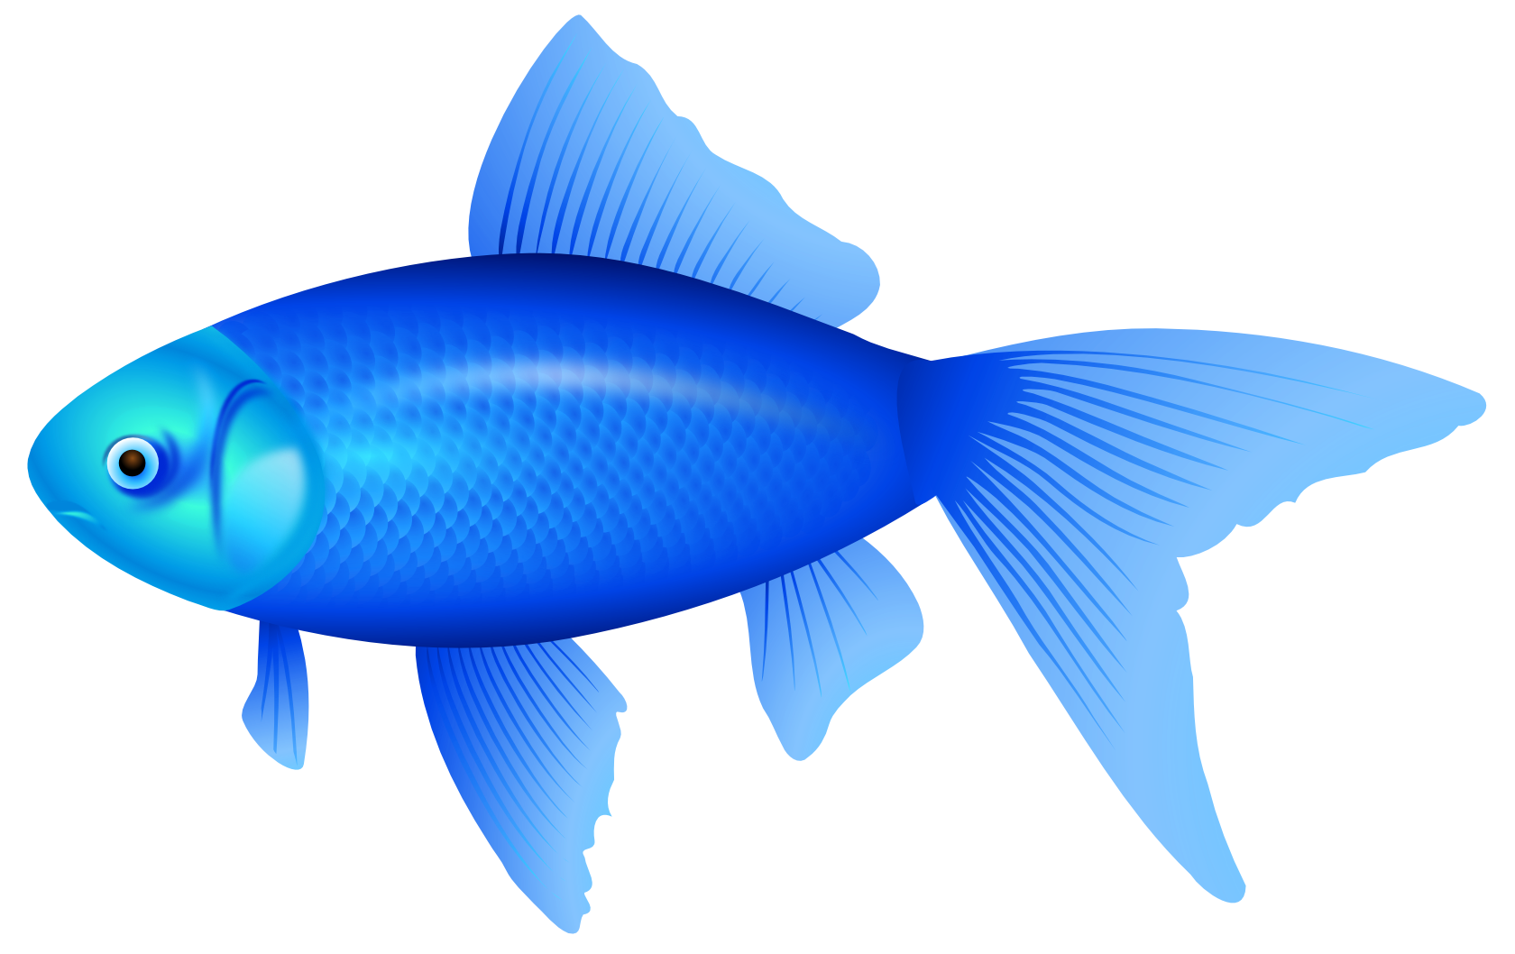

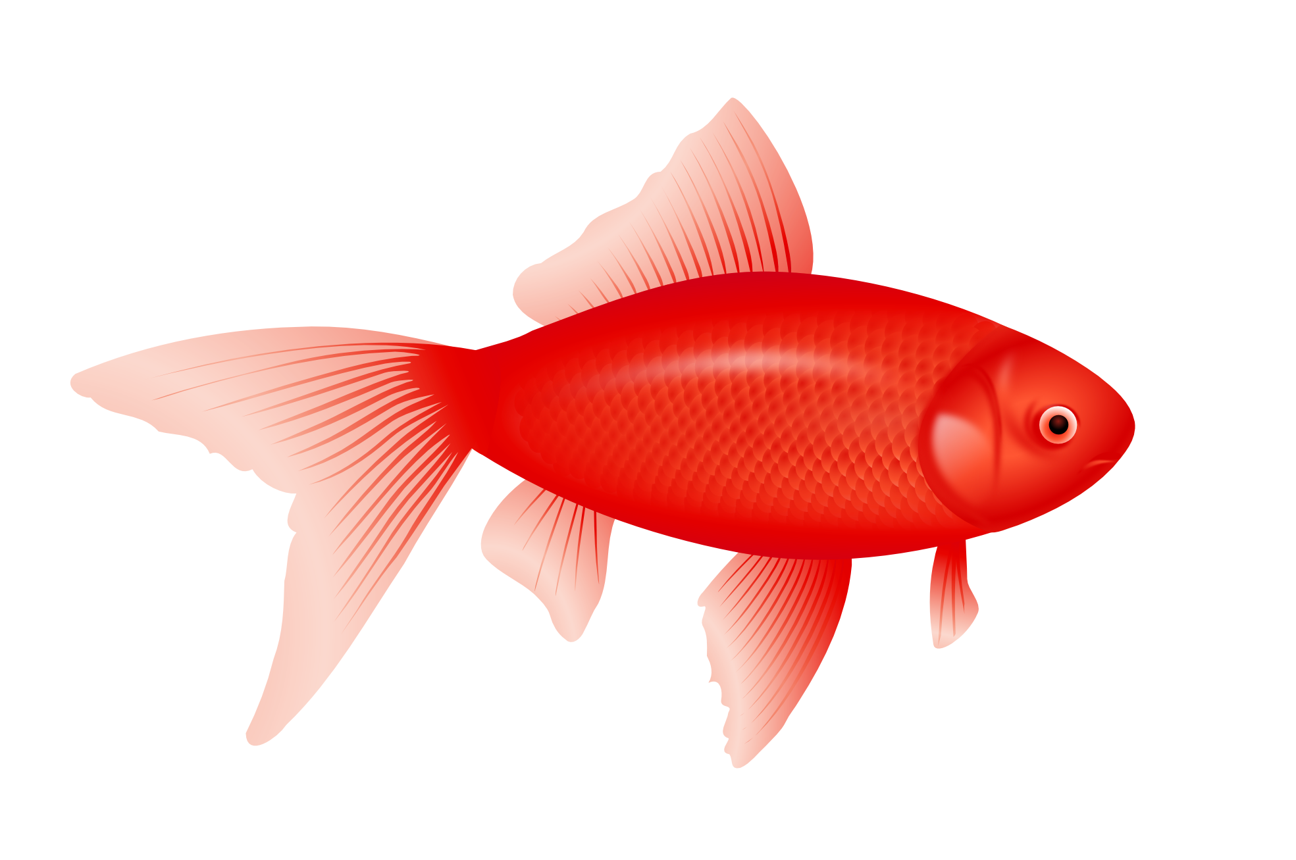


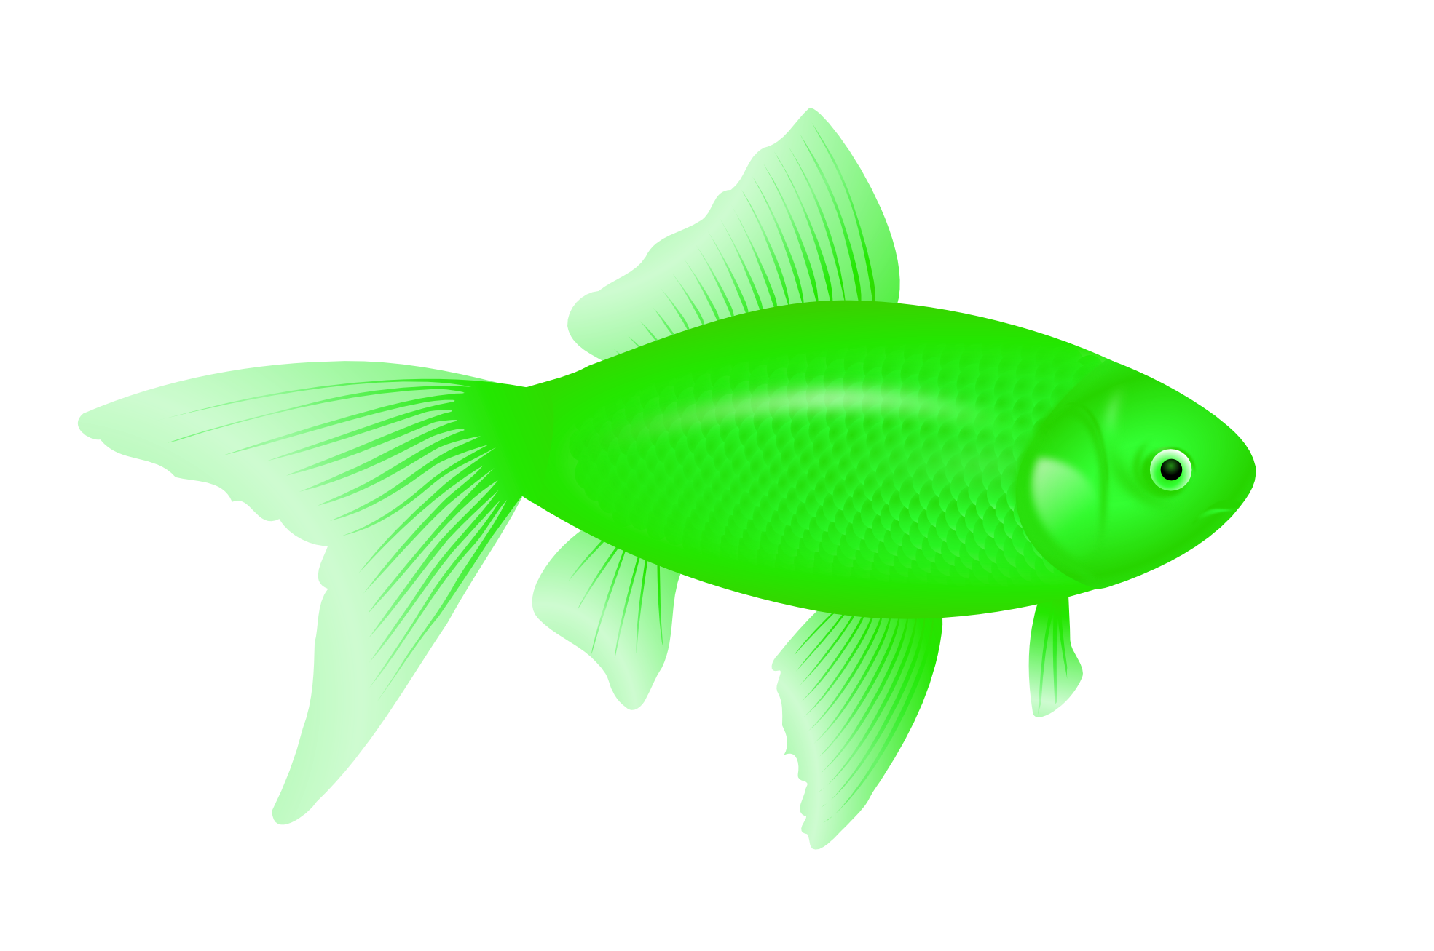
Execution Plan
Multi-Stream Strategy & Stronger Entropy
Use 2–3 independent streams:
If streams are independent, combine samples (e.g., XOR or concatenation) — increases entropy.
Rotate which streams and which fish are used to prevent long-term correlation.
Hopefully, combined streams raises entropy but need to look out for sources that share common noise

Slide 29
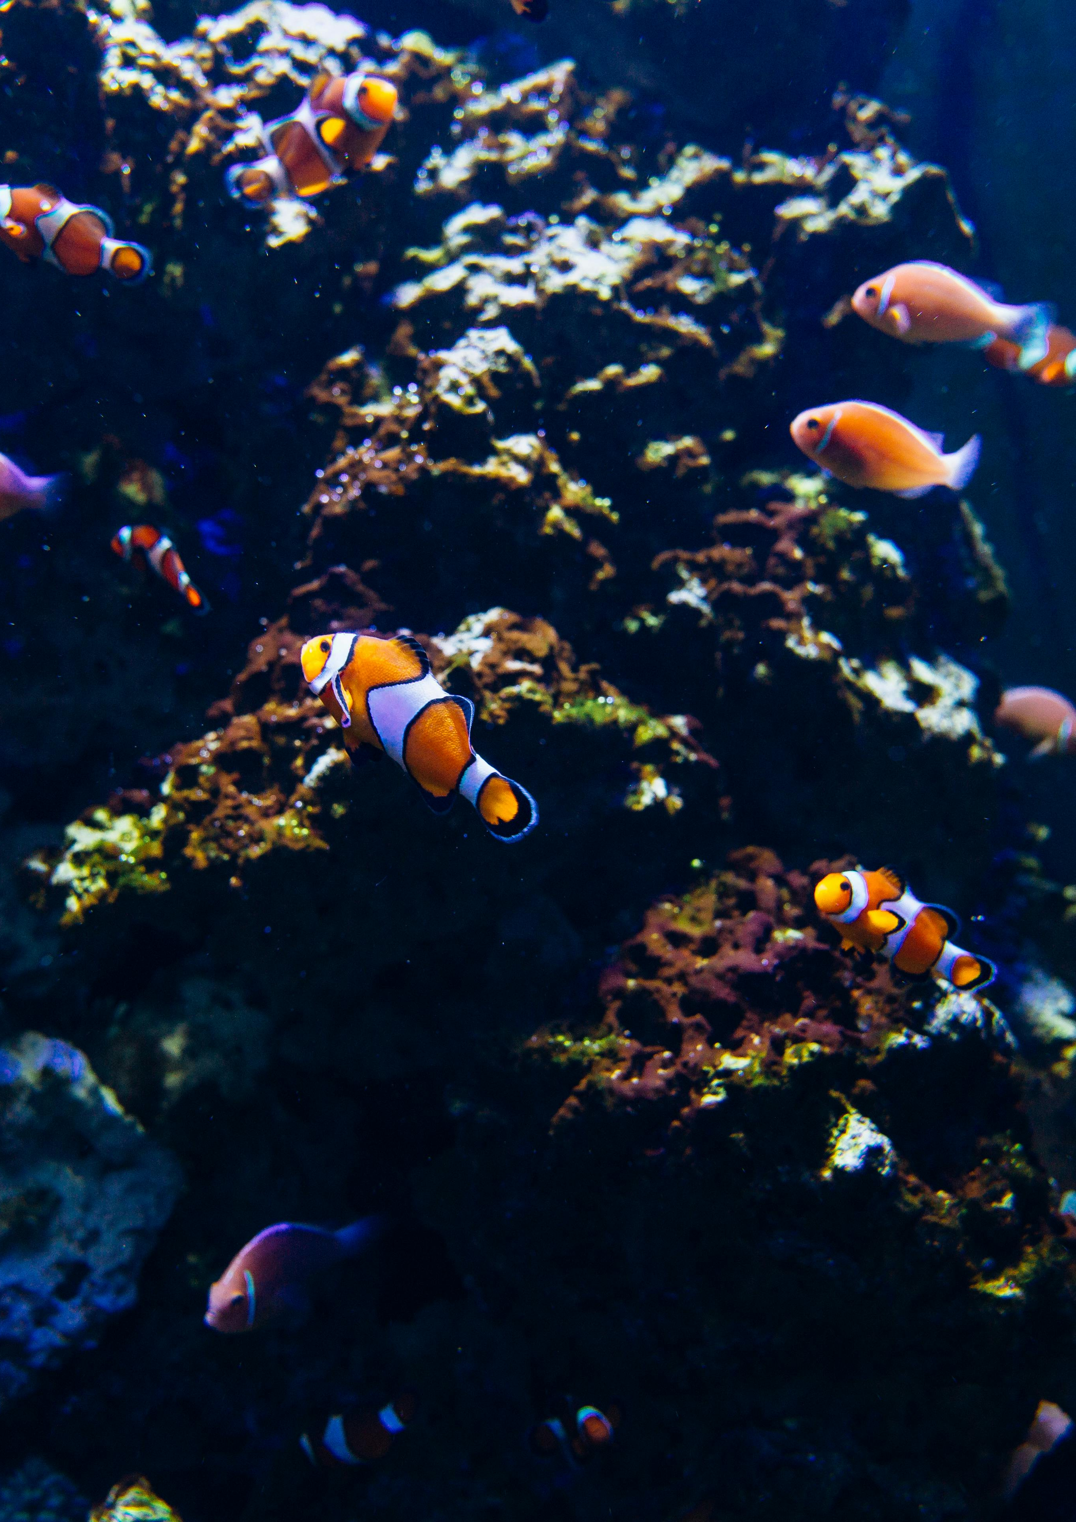
Execution Plan
Data Collection & Preprocessing Pipeline
Resize frames to uniform dimensions (e.g., 640×480).
Filter out stationary fish using minimum speed thresholds.
Handle network latency and stream desynchronization, fallback to single stream if needed.
Enable detailed error reporting for all discarded or rejected samples to facilitate troubleshooting and audit trails.

Slide 30
Execution Plan
Testing, Metrics & Hardening
Tests:
statistical tests such as NIST SP800-22, Dieharder, ENT (run on final keys).
Entropy estimation (min-entropy per bit).
Hardening:
Discard samples when network frames drop or when detection confidence is low.
Log metrics (detection rates, sample counts, hash inputs).
If entropy below threshold, do not issue a key.

Slide 31
Execution Plan
Deliverables
Demo video of our program
Showing of the single stream vs multi-stream entropy evaluation
Run the randomness test and assess the functionality of our implementation

Slide 32

Questions

Slide 33
Reference
https://spectrum.ieee.org/aquaculture
https://explore.org/livecams/aquarium-of-the-pacific/pacific-aquarium-tropical-reef-camera
https://doge.tg/blog/2018/The-2013-Android-Bitcoin-Wallet-Vulnerability-A-Lesson-in-Randomness/
[NIST 2010] Rukhin, A., et al. A Statistical Test Suite for Random and Pseudorandom Number Generators for Cryptographic Applications (SP 800-22 Rev.1a). NIST, 2010. https://csrc.nist.gov/publications/detail/sp/800-22/rev-1a/final
[Lenstra 2012] Lenstra, A. K., Hughes, J. P., Augier, M., Bos, J. W., Kleinjung, T., & Wachter, C. “Ron was wrong, Whit is right.” IACR ePrint Archive, 2012. https://eprint.iacr.org/2012/064.pdf
[Bonneau 2013] Bonneau, J., & Mironov, I. “Blockcipher-based PRNGs and Security Failures.” IEEE Symposium on Security and Privacy (S&P), 2013. https://ieeexplore.ieee.org/document/6547124
[RFC 4086] Eastlake, D. “Randomness Requirements for Security.” RFC 4086, IETF, 2005. https://www.rfc-editor.org/rfc/rfc4086
[Barak 2019] Barak, B., et al. “True Randomness from Biological Systems.” Journal of Cryptographic Engineering, 2019. https://link.springer.com/article/10.1007/s13389-019-00209-9

